Slide 1
NT219- Cryptography
Week 10: Hash Function and Message Authentication Codes (P2)
PhD. Ngoc-Tu Nguyen
tunn@uit.edu.vn

Slide 2
Outline
Motivations
Hash function
CRC
Cryptographic Hash function
SHA2
SHA3
Message authentication code
Notes:
Cipher=a secret system of writing;

Slide 3
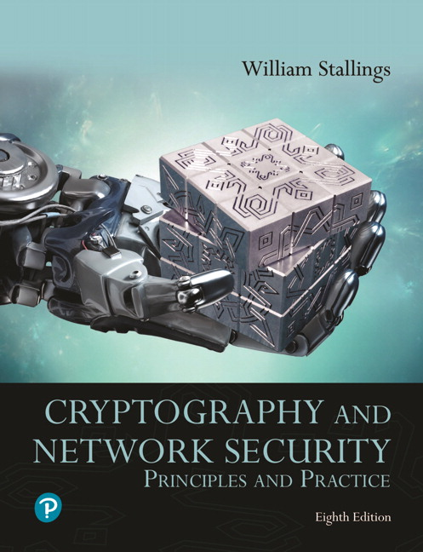
Textbooks and References
Text books
[1] Chapter 11,12

Slide 4
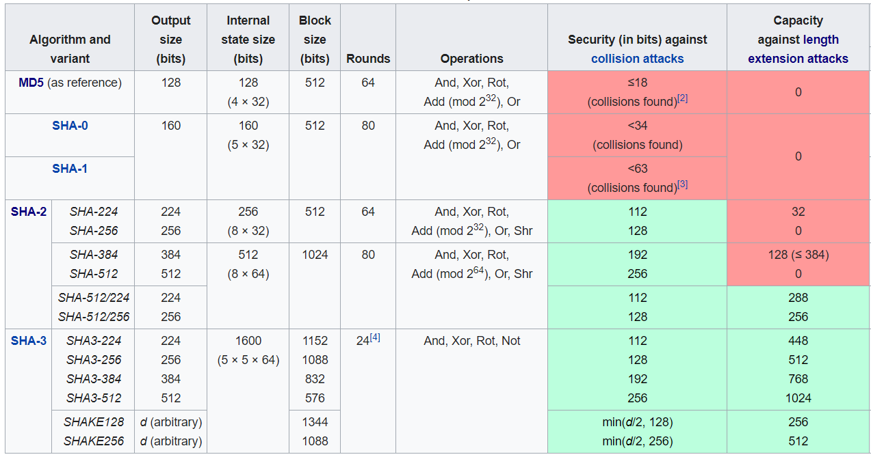
SHA-1, SHA-2, SHA-3
https://en.wikipedia.org/wiki/Secure_Hash_Algorithms

Slide 5
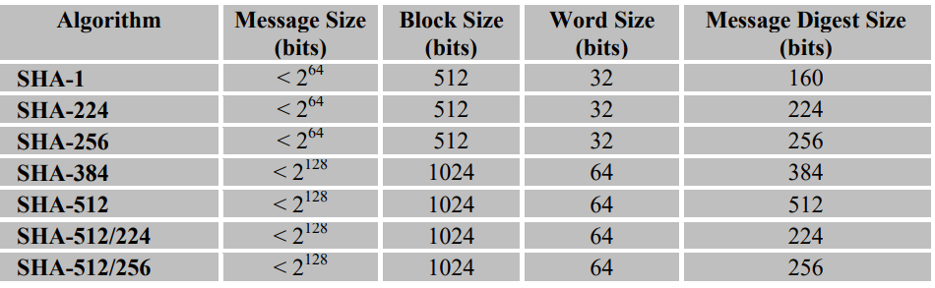
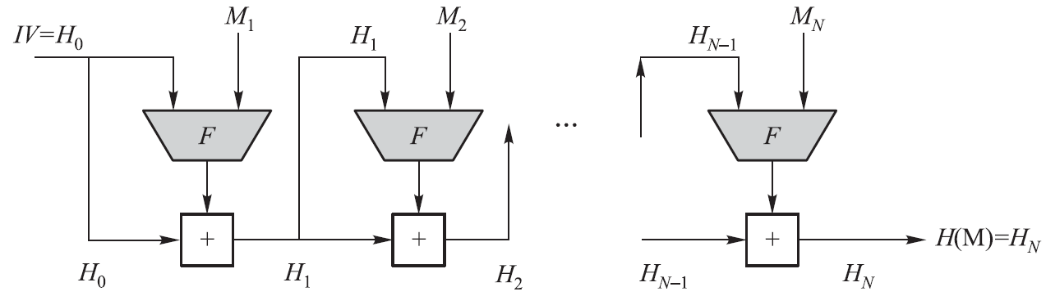
SHA-1, SHA-2
Merkle-Damgard Construction
https://csrc.nist.gov/publications/fips#fips180-4

Slide 6
Merkle-Damgard Construction for Hash Functions
SHA-1, SHA-2 (a series of hash functions), and WHIRLPOOL all have the same basic structure
The heart of this basic structure is a compression function F
Different hash algorithms use different compression functions
Use a CBC mode of repeated applications of F without using secret keys
M is a plaintext block, IV is an initial vector, F is a compression function, and “+” is some form of modular addition operation
Notes:
CBC=Cipher block chaining

Slide 7
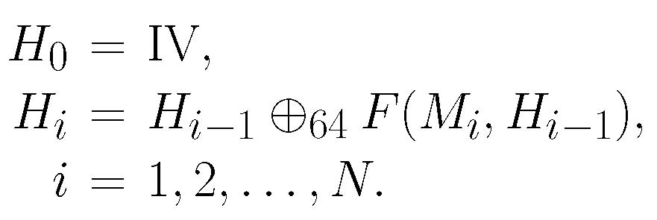
Merkle-Damgard Construction for Hash Functions
The M’s digital fingerprint is H(M) = H_{N}, where
SHA-512
Notes:
CBC=Cipher block chaining

Slide 8

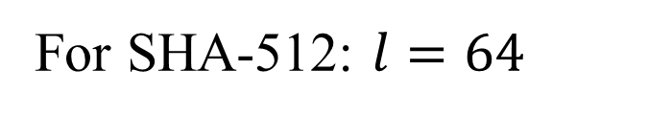
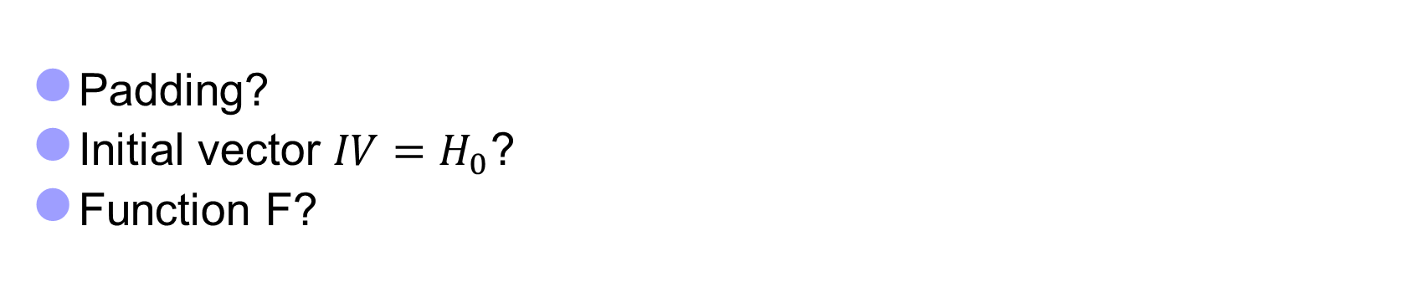
SHA-512 Algorithm
Let X = X₁X₂…X_{k}, Y = Y₁Y₂…Y_{k} be binary strings, where each X_{i},Y_{i} is an l-bit binary string. Generalize the bitwise-XOR operation to an l-bitwise-XOR operation as follows:
For SHA-512: $l=64$
Padding?
Initial vector ${IV=H}_{0}$?
Function F?
Y
X

Slide 9
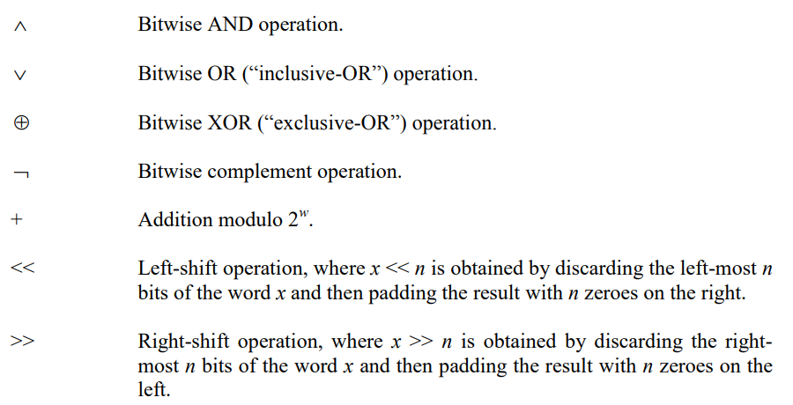
SHA-512 Compression Function (III)

Slide 10
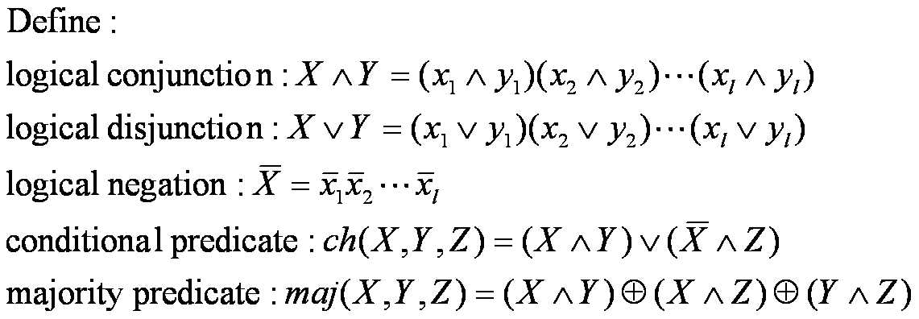
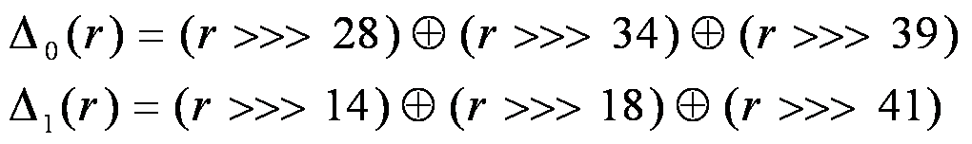
SHA-512 Compression Function (III)
Bitwise operations

Slide 11
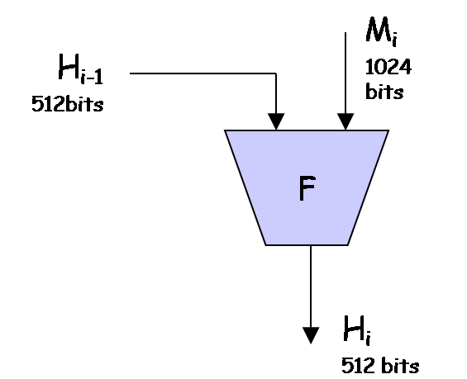
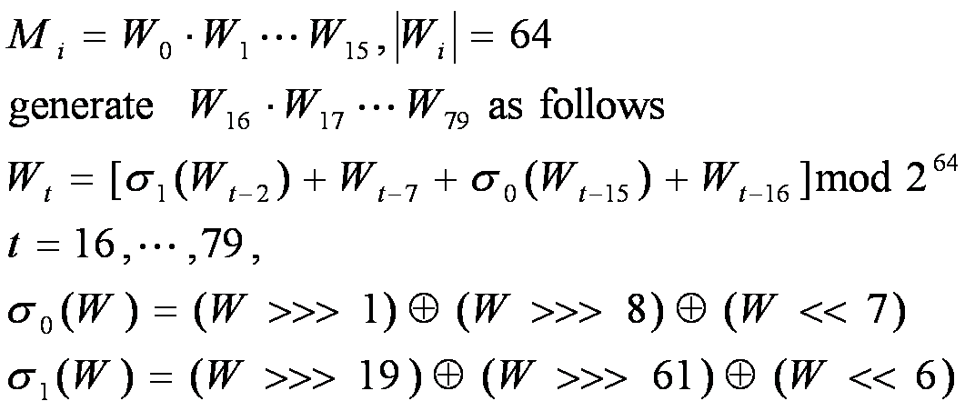
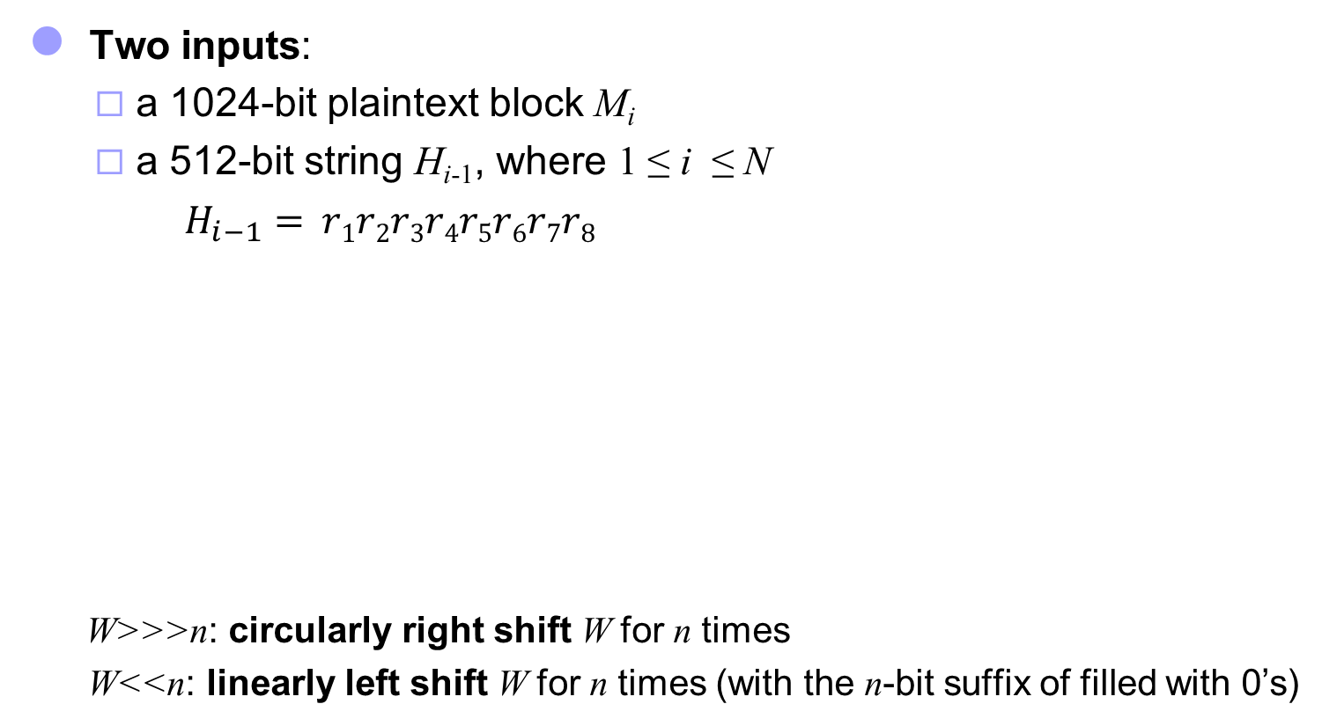
SHA-512 Compression Function (IlI)
Two inputs:
a 1024-bit plaintext block M_{i}
a 512-bit string H_{i-1}, where 1 ≤ i ≤ N
$H_{i−1}= r1r2r3r4r5r6r7r8$
W>>>n: circularly right shift W for n times
W<<n: linearly left shift W for n times (with the n-bit suffix of filled with 0’s)

Slide 12

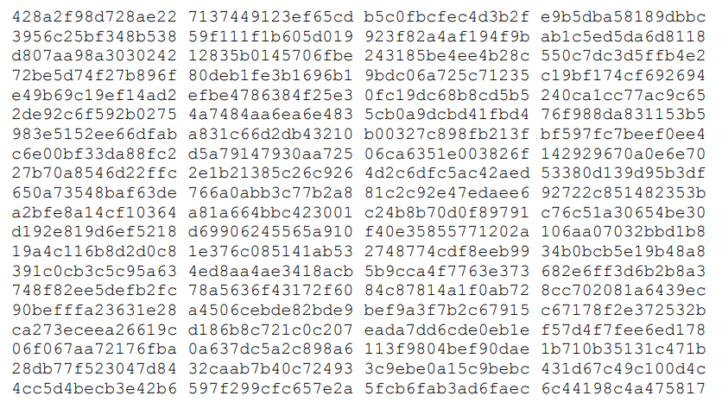
SHA-512 Compression Function (III)
: first sixty-four bits of the fractional parts of the cube roots of the first eighty prime numbers

Slide 13
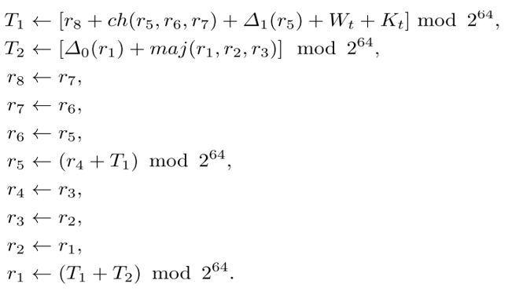
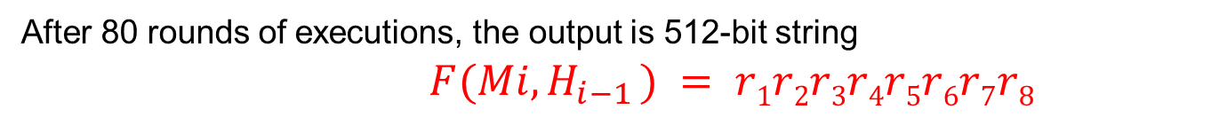
SHA-512 Compression Function (III)
$H_{i−1}= r1r2r3r4r5r6r7r8$, $W_{0},$ $W_{1},…,W_{79}$, $K_{0},$ $K_{1},…,K_{79}$
For each i is executed 80 rounds:
t=0,1,2,..79
After 80 rounds of executions, the output is 512-bit string
$F(Mi, H_{i−1} ) = r1r2r3r4r5r6r7r8$

Slide 14





Length extension attack on SHA2
$$EX$$
$$H_{N}$$
$$H^{∗}$$
$$H$$
$$H(K||M)=H(K||M||padded)$$
$$H(K||M||padded||EX) =H^{∗}(EX)$$
can compute $H(M||padded||EX)$without knowing the input $M$
$$H(M|\left|K\right)−→OK$$

Slide 15
SHA3 Standard
SHA-3 provides an alternative to SHA-2, and is drop-in compatible with any system using SHA-2
SHA-3 uses a sponge construction, instead of the CBC mode of repeated compressions used by SHA-1, SHA-2, and Whirlpool
https://nvlpubs.nist.gov/nistpubs/FIPS/NIST.FIPS.202.pdf

Slide 16
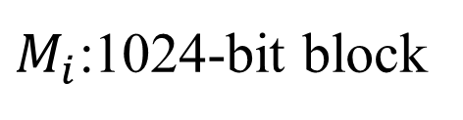
SHA-512 Initial Process (I)
Padding process
M M’= M₁M₂…M_{N}
$M_{i}$:1024-bit block
1024 bits
1024 bits
1024 bits?
Length(M)=L
M’ = M || 1(0^{l}) || b₁₂₈(L), where l ≥ 0

Slide 17
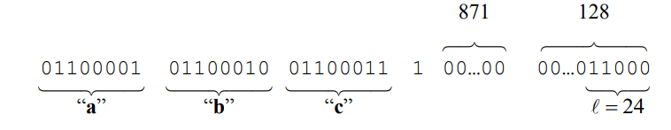
SHA-512 Initial Process (I)
Padding process
Example: M=abc
M’ (1024 bits)
Length(M)=24
M’ = M || 1(0^{l}) || b₁₂₈(L), where l =1024 -24 -1 -128 = 871
L

Slide 18
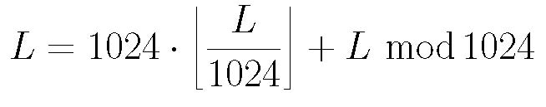
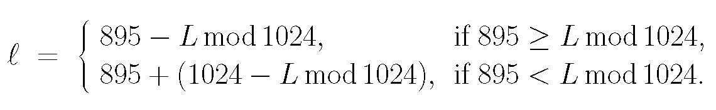

SHA-512 Initial Process (II)
Set Γ = 2¹²⁸ – 1 and γ = 512
M is a binary with |M| = L ≤ Γ
Represent L as a 128-bit binary string, denoted by b₁₂₈(L)
Pad M to produce a new binary string M’ as follows:
M’ = M || 1(0^{l}) || b₁₂₈(L), where l ≥ 0
such that |M’| (denoted by L’) is divisible by 1024. We have
L’ = L + (1 + l) + 128 = L + l + 129 = L + (1024 – 895) + l
L can be represented as
Hence, l can be determined as follows:
Thus, L’ is divisible by 1024. Let L’ = 1024N and write as a sequence of 1024-bit blocks: M’ = M₁M₂…M_{N}
Padding process
M M’
M’ = M || 1(0^{l}) || b₁₂₈(L),
where l ≥ 0
M’ = M₁M₂…M_{N}
$$len(M_{i}) =1024$$

Slide 19

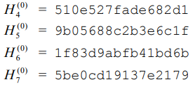


SHA-512 Initial Process (II)
SHA-512 uses a 512-bit IV
Let r₁, r₂, r₃, r₄, r₅, r₆, r_{7,} and r₈ be eight 64-bit registers
Initially they are set to, respectively, the 64-bit binary string in the prefix of the fractional component of the square root of the first 8 prime numbers:
√2, √3, √5, √7, √11, √13, √17, √19
$$H^{(0)}=\text{IV}$$

Slide 20
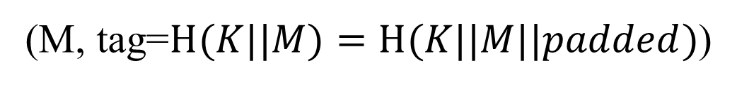

Length extension attack on SHA2
$$EX$$
$$H_{N}$$
$$H^{∗}$$
$$H$$
(M, tag=$H(K||M)=H(K||M||padded)$)
$$(M\left|\left|padded\right|\right|EX, tag^{′}=H(K||M||padded|\left|EX\right)=H^{∗}\left(EX\right))$$
can compute $H(M||padded||EX)$without knowing the input $M$

Slide 21
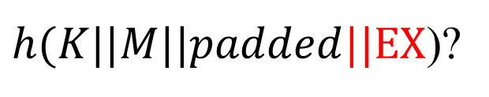



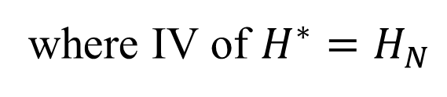
Length extension attack on SHA2
$h(K||M||padded||EX$)?
$$EX=M_{ex1}|\left|M_{ex2}\right||…$$
$$M_{ex1}$$
$$H(K||M)=H(K||M|\left|padded\right)=H_{N}$$
Compute $H(K||M||padded||EX)$without knowing the input $K, M$
$$H\left(K||M\left|\left|padded\right|\right|EX\right)=H^{∗}\left(EX\right),$$
where IV of $H^{∗}=H_{N}$

Slide 22
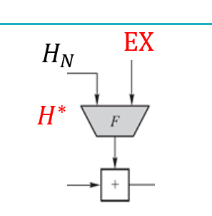



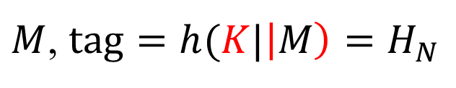







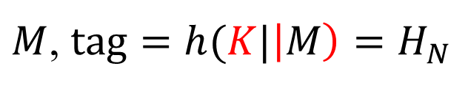
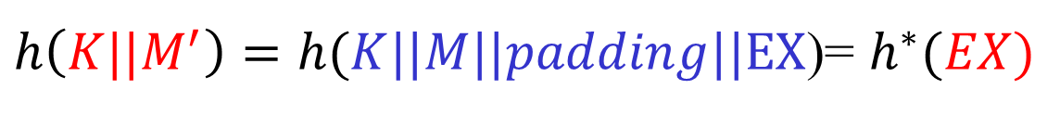
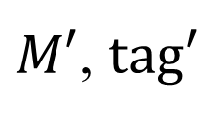


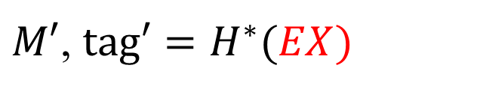
Length extension attack on SHA2
$$K$$
$$K$$
$M$, $tag=h(K|\left|M\right)=H_{N}$
${M→M}^{′}=M\left|\left|padding\right|\right|EX$, ${tag}^{′}=h\left({K||M}^{′}\right)=H^{∗}(EX)$
$$K$$
$$K$$
$M$, $tag=h(K|\left|M\right)=H_{N}$
$M′$, $tag′=H^{∗}(EX)$
$M′$, $tag′$
$$H_{N}$$
$$M_{ex1}$$
$$M_{ex2}$$
$h\left({K||M}^{′}\right)=h(K||M||padding||EX$)= $h^{∗}(EX)$
$$EX=M_{ex1}|\left|M_{ex2}\right||…$$
$$H_{N+1}$$

Slide 23
SHA3 Standard
SHA-3 provides an alternative to SHA-2, and is drop-in compatible with any system using SHA-2
SHA-3 uses a sponge construction, instead of the CBC mode of repeated compressions used by SHA-1, SHA-2, and Whirlpool
https://nvlpubs.nist.gov/nistpubs/FIPS/NIST.FIPS.202.pdf

Slide 24
NIST SHA-3
2007: Request for submissions of new hash functions
2008: Submissions deadline. Received 64 entries. Announced first-round selections of 51 candidates.
2009: After First SHA-3 candidate conference in Feb, announced 14 Second Round Candidates in July.
2010: After one year public review of the algorithms, hold second SHA-3 candidate conference in Aug. Announced 5 Third-round candidates in Dec.
2011: Public comment for final round
2012: October 2, NIST selected SHA3
Keccak (pronounced “catch-ack”) created by Guido Bertoni, Joan Daemen and Gilles Van Assche, Michaël Peeters

Slide 25
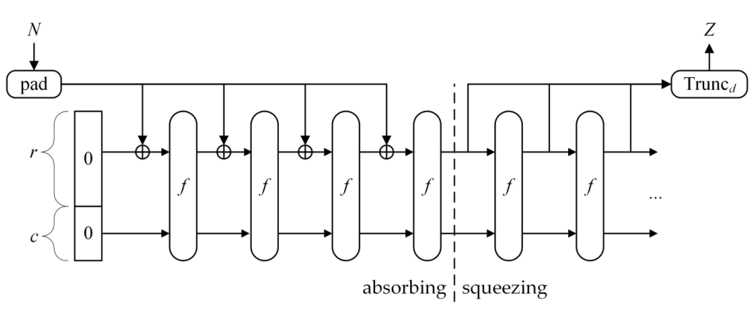
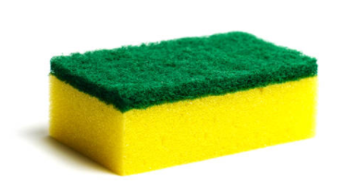
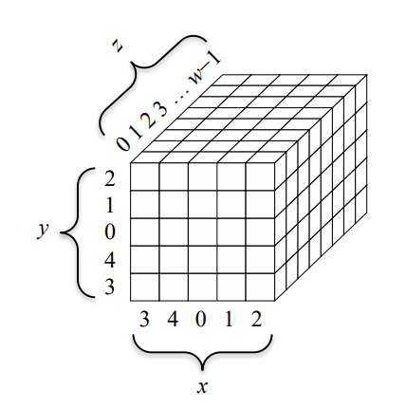




SHA3 Standard
Sponge construction (Keccak)
$$P_{0}$$
$$P_{1}$$
$$…$$
$$P_{N−1}$$
r (block size)
c=2d = 2.(output length)
Let M be the input string; d = the hash length.
b = r + c, where c = 2d
r is called rate and c capacity
Where
Bertoni, G., Daemen, J., Peeters, M., Van Assche, G., & Van Keer, R. (2012). Keccak implementation overview. URL: http://keccak. neokeon. org/Keccak-implementation-3.2. pdf.

Slide 26
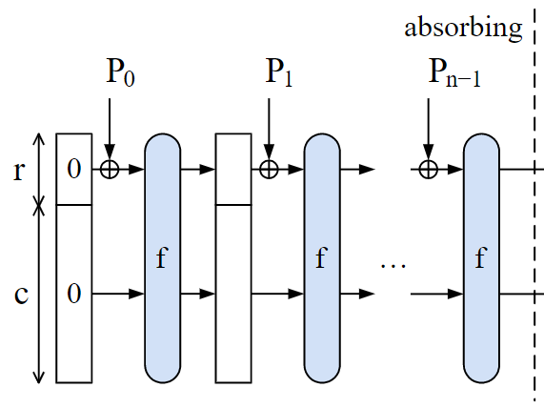
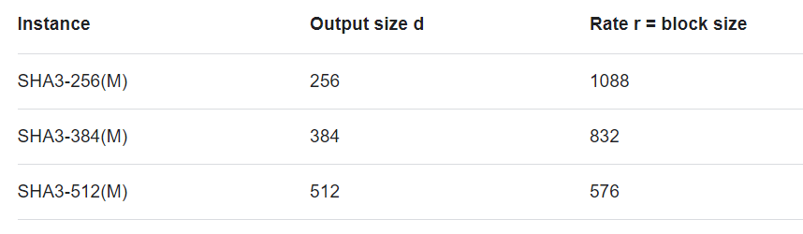
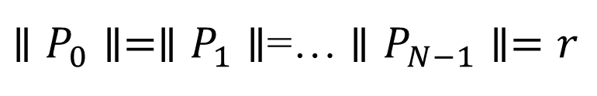

Example
$$P_{i}$$
IV
Let M be the input string; d = the hash length.
b = r + c, where c = 2d
r (block size) is called rate, and c=2d capacity
Where
Ex. d = 512, then c = 1024.
Choose b = 1600, then r = 576.
2d
$∥P_{0}∥=∥P_{1}∥$=… $∥P_{N−1}∥=r$

Slide 27
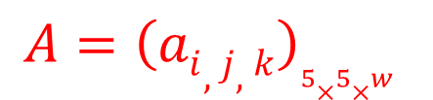
Setup
Pad M by appending 1{0}*1 to produce M’ such that |M’| is divisible by r.
Divide M’ into N = |M’|/r blocks: M₁, …, M_{N}
Let A be a b-bit string and denote A as a 5X5 matrix
Let a_{i,j,k} denote the k^{th} bit in a_{i,j}
Let f_{b} be a fixed-length permutation on b-bit inputs
Let p_{r} = pfx_{r}, s_{c} = sfx_{c}
$$A={\left(ai,j,k\right)}_{5×5×w}$$

Slide 28
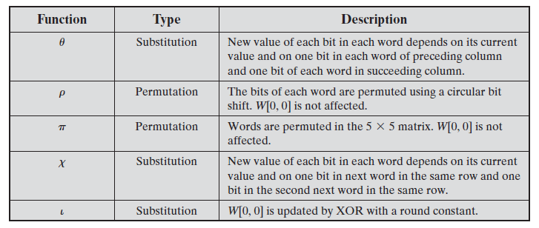
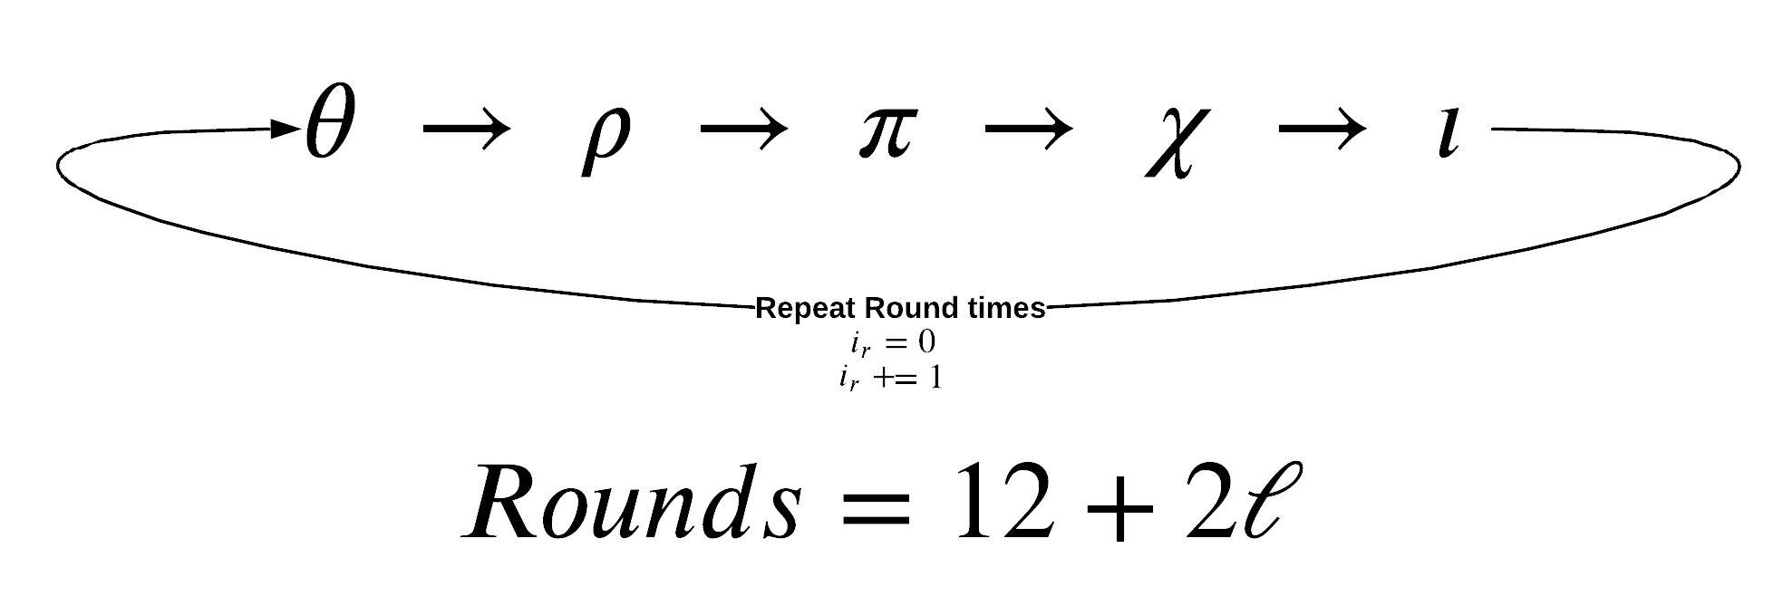
Absorb and Squeeze
https://chemejon.io/sha-3-explained/

Slide 29

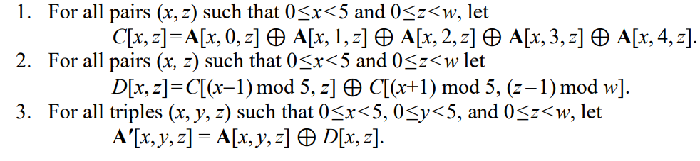
Absorb and Squeeze
A
https://nvlpubs.nist.gov/nistpubs/FIPS/NIST.FIPS.202.pdf

Slide 30


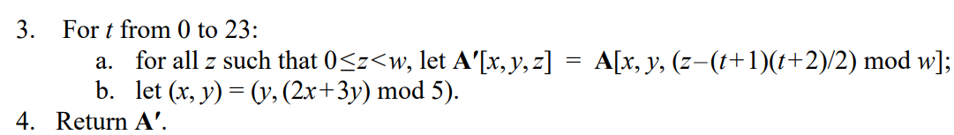
Absorb and Squeeze
A
https://nvlpubs.nist.gov/nistpubs/FIPS/NIST.FIPS.202.pdf

Slide 31

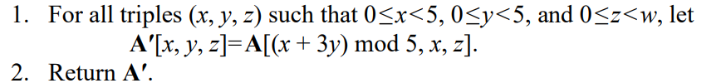
Absorb and Squeeze
A
https://nvlpubs.nist.gov/nistpubs/FIPS/NIST.FIPS.202.pdf

Slide 32

Absorb and Squeeze
A
“.” “ integer multiplication
https://nvlpubs.nist.gov/nistpubs/FIPS/NIST.FIPS.202.pdf

Slide 33

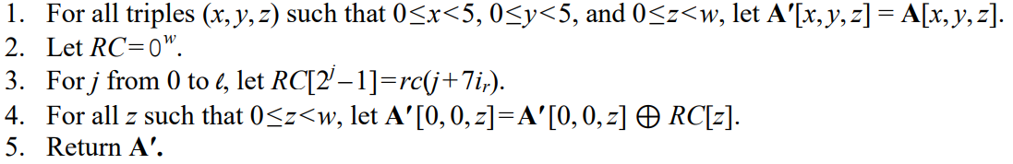
Absorb and Squeeze
A
https://nvlpubs.nist.gov/nistpubs/FIPS/NIST.FIPS.202.pdf

Slide 34

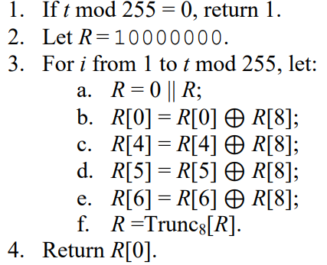
Absorb and Squeeze
round constant
A

Slide 35



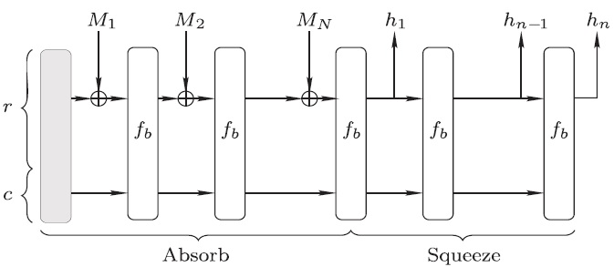
Absorb and Squeeze
Absorb:
Squeeze:

Slide 36
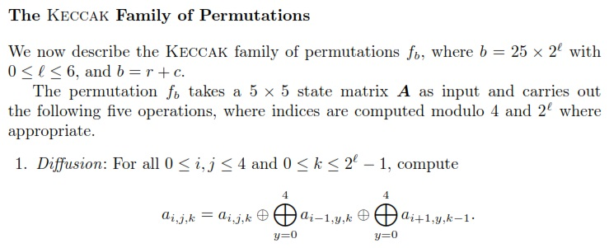
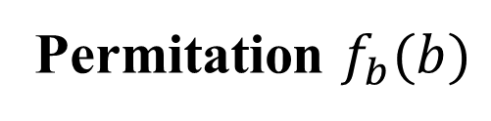
SHA-3 Hash
Permitation $f_{b}(b)$

Slide 37
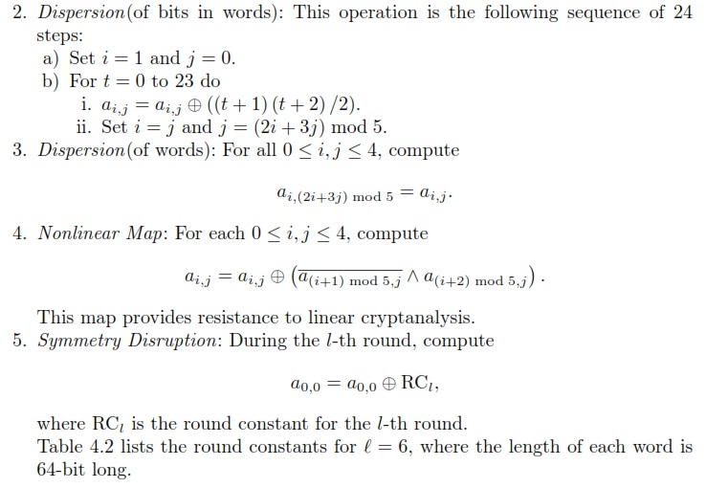
SHA-3 Hash

Slide 38
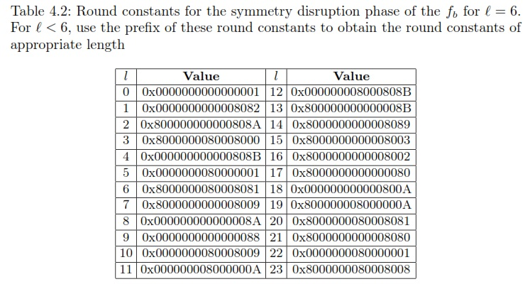
SHA-3 Hash

Slide 39

The Sponge Construction: Used by SHA-3
Each round, the next r bits of message is XOR’ed into the first r bits of the state, and a function f is applied to the state.
After message is consumed, output r bits of each round as the hash output; continue applying f to get new states
SHA-3 uses 1600 bits for state size

Slide 40
Choosing the length of Hash outputs
The Weakest Link Principle:
A system is only as secure as its weakest link.
Hence all links in a system should have similar levels of security.
Because of the birthday attack, the length of hash outputs in general should double the key length of block ciphers
SHA-224 matches the 112-bit strength of triple-DES (encryption 3 times using DES)
SHA-256, SHA-384, SHA-512 match the new key lengths (128,192,256) in AES
SHAKE: ouput length d
Notes:
Which hash function to use?

Slide 41


Limitation of Using Hash Functions for Data Authentication
Is this secure scheme (M cannot be modified)?
Case 1:
$$M, h(M)$$
$$h\left(M\right) (secure channel)$$
UBUNTO 20 ISO
Require an authentic channel to transmit the hash of a message
Without such a channel, it is insecure, because anyone can compute the hash value of any message, as the hash function is public
Such a channel may not always exist
How to address this?
use more than one hash functions
use a key to select which one to use

Slide 42

Message Authentication Code
tag
Collision
resistance
MAC=MAC(M, K)
https://en.wikipedia.org/wiki/Message_authentication_code

Slide 43

Message Authentication Code
CMAC: https://csrc.nist.gov/pubs/sp/800/38/b/upd1/final

Slide 44

Message Authentication Code CMAC

Slide 45



Message Authentication Code GMAC
….
n
….
n
….
n
GCM
….
….
Page 19 for
$$Mult_{H}$$
$$C=C_{1} || …||C_{n}$$
(C, auth tag)
https://csrc.nist.gov/pubs/sp/800/38/d/final
https://csrc.nist.gov/projects/crypto-publication-review-project

Slide 46




Keyed-Hash Message Authentication Code HMAC
A hash family (H) use for message authentication
MAC(K,M) = H_{K}(M)
The sender and the receiver share secret K
The sender sends (M, H_{k}(M))
The receiver receives (X,Y) and verifies that H_{K}(X)=Y, if so, then accepts the message as from the sender
To be secure, an adversary shouldn’t be able to come up with (X’,Y’) such that H_{K}(X’)=Y’.
$$K$$
$$K$$
$M$, tag=$H(K, M)$
$M^{′}, tag′=H(K,M′)$?=tag

Slide 47
Security Requirements for MAC
Resist the Existential Forgery under Chosen Plaintext Attack
Challenger chooses a random key K
Adversary chooses a number of messages M₁, M₂, .., M_{n}, and obtains t_{j}=MAC(K,M_{j}) for 1≤j≤n
Adversary outputs M’ and t’
Adversary wins if ∀j M’≠M_{j}, and t’=MAC(K,M’)
Basically, adversary cannot create the MAC for a message for which it hasn’t seen an MAC
Notes:
Good homework problem, break simple MAC constructions.
MAC uses shared secret key to bootstrap integrity/authenticity.

Slide 48
Constructing MAC from Hash Functions
Let h be a one-way hash function (SHA2)
MAC(K,M) = h(K || M), where || denote concatenation
Insecure as MAC
Because of the Merkle-Damgard construction for hash functions, given M and t=h(K || M), adversary can compute M’=M||Pad(M)||X and t’, such that h(K||M’) = t’

Slide 49

Constructing MAC from Cryptographic Hash Functions HMAC
HMAC_{K}[M] = Hash[(K⁺ ⊕ opad) || Hash[(K⁺ ⊕ ipad)||M)]]
K⁺ =$K||{\left\{0\right\}}^{∗}$(to B bytes, the input block size of the hash function)
ipad = 0x36 0x36 … 0x36 (repeated B times)
opad = 0x5C 0x5C …. 0x5C (repeated B times).
At high level, HMAC_{K}[M] = H(K || H(K || M))

Slide 50




Authentication and Integrity checking
$$K$$
$$K$$
$M$, $tag=h(K,M)$
h(K, M) = h[(K⁺ ⊕ opad) || Hash[(K⁺ ⊕ ipad)||M)]]
K⁺ =$K||{\left\{0\right\}}^{∗}$(to B bytes, the input block size of the hash function)
ipad = 0x36 0x36 … 0x36 (repeated B times)
opad = 0x5C 0x5C …. 0x5C (repeated B times).
Pros and Cons?

Slide 51







Authenticate user/end-devices case
(1) Password-based Authentication
$store:name, h(pw)$
$name, pw$
Login
Provide $name, pw′$ to server?
Locate the row using name
Check $h\left(pw^{′}\right)?=$ $h\left(pw\right)$
authenticate the user
Notes:
authentication factors= Các yếu

Slide 52
HMAC Security
If used with a secure hash functions (e.g., SHA3-256) and according to the specification (key size, and use correct output), no known practical attacks against HMAC

Slide 53
Dictionary attacks on hash function
h(password)= b1b6a3de29ab907153614683d357b2db943a317d036ff25f7022d4707109005a
password=?
Guest password | sha256 | sha384 | sha512 | …
abc123 | … | … | ….. | …
abcd1234 | … | …. | … | …
….
Rainbow table
https://hashkiller.io/

